Slide 1
ECE249:
Unit-4
PN junction diode and its applications

Slide 2
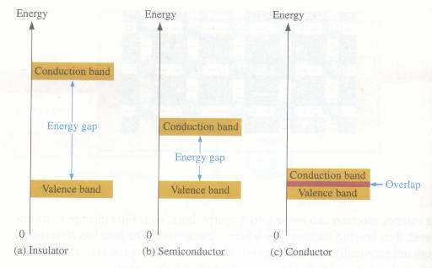
Basic Diode Concepts
* Energy Diagrams – Insulator, Semiconductor, and Conductor
the energy diagram for the three types of solids

Slide 3
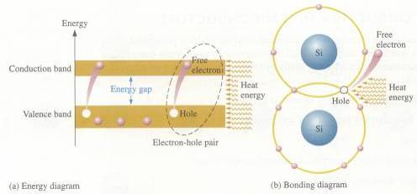
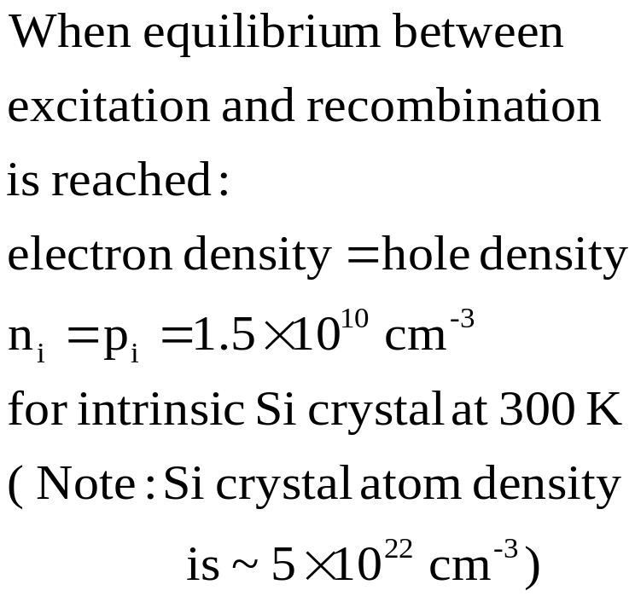
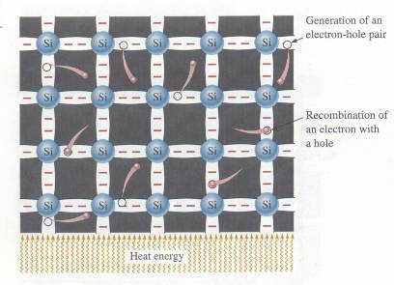
Intrinsic Semiconductors
* Intrinsic (pure) Si Semiconductor:

Slide 4
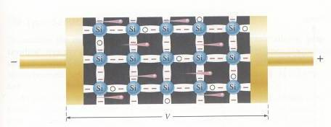
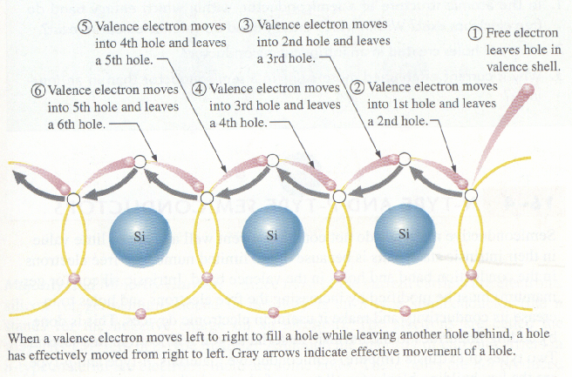
Intrinsic Semiconductors
*Apply a voltage across
a piece of Si:
electron current
and hole current

Slide 5
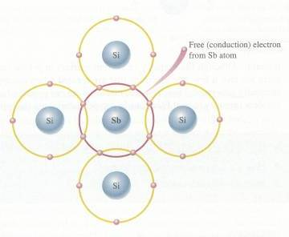
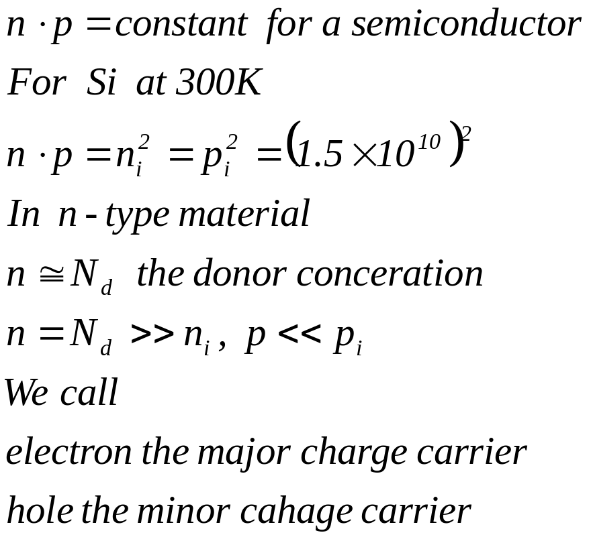
N- and P- Type Semiconductors
* Doping: adding of impurities (i.e., dopants) to the intrinsic semi-conductor material.
* N-type: adding Group V dopant (or donor) such as As, P, Sb,…

Slide 6
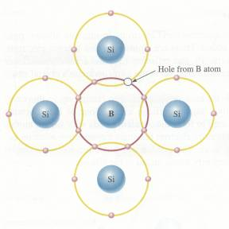
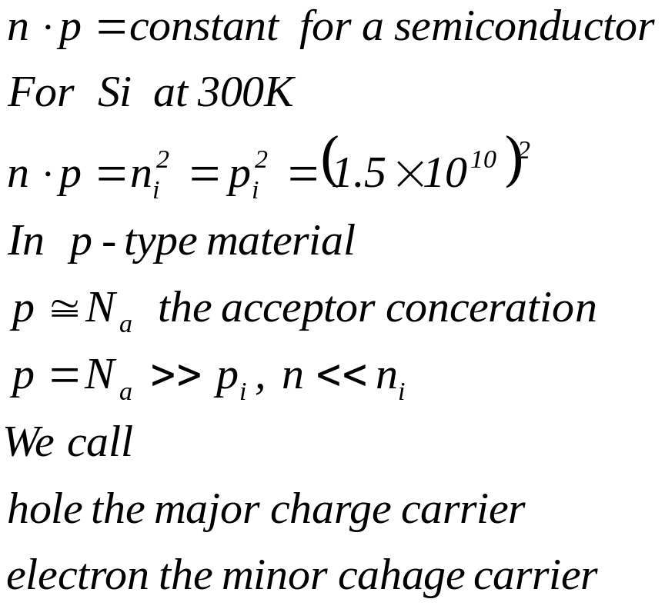
N- and P- Type Semiconductors
* Doping: adding of impurities (i.e., dopants) to the intrinsic semi-conductor material.
* P-type: adding Group III dopant (or acceptor) such as Al, B, Ga,…

Slide 7
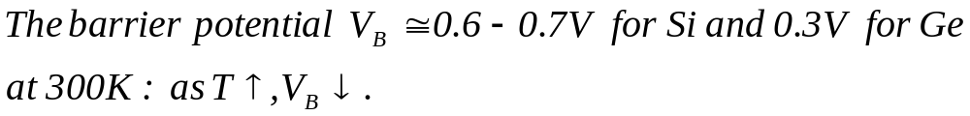
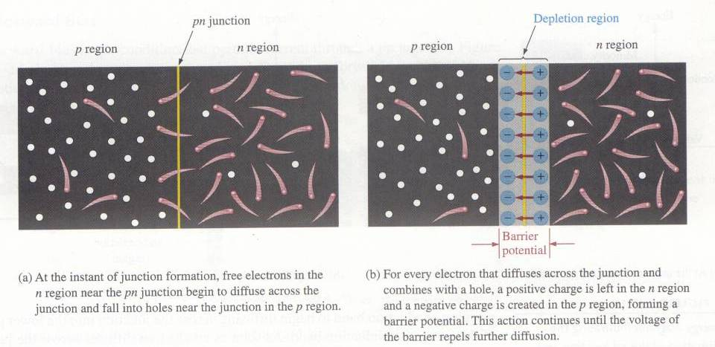
The PN-Junction
* The interface in-between p-type and n-type material is called a
pn-junction.

Slide 8
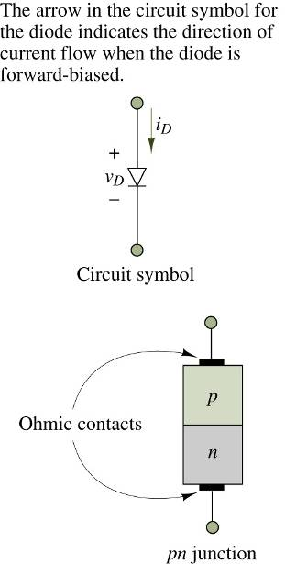
Biasing the PN-Junction
* There is no movement of charge through a PN-junction at equilibrium.
* The PN-junction form a diode which allows current in only one direction and prevent the current in the other direction as determined by the bias.

Slide 9
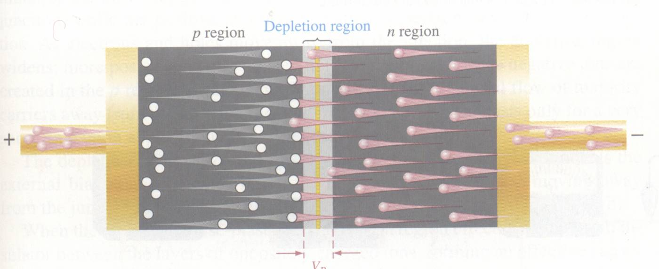
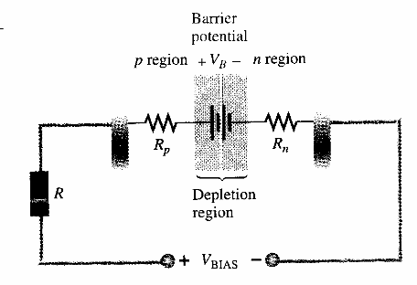
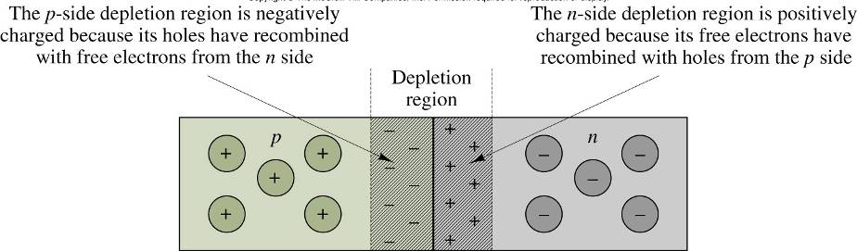
Diodes – Basic Diode Concepts
Biasing the PN-Junction
*Forward Bias: dc voltage positive terminal connected to the p region and negative to the n region. It is the condition that permits current through the pn-junction of a diode.

Slide 10
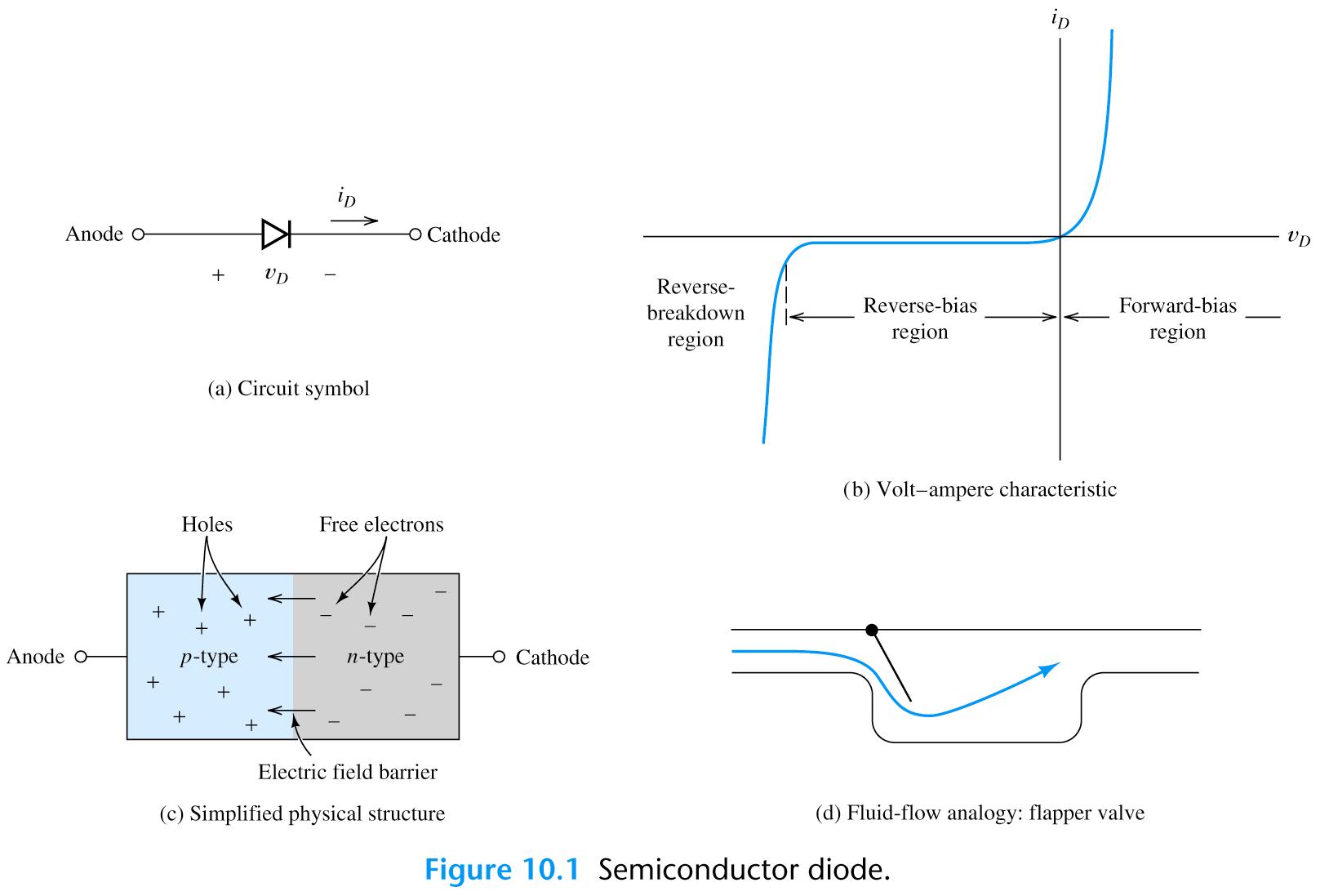
Biasing the PN-Junction
*Forward Bias:

Slide 11
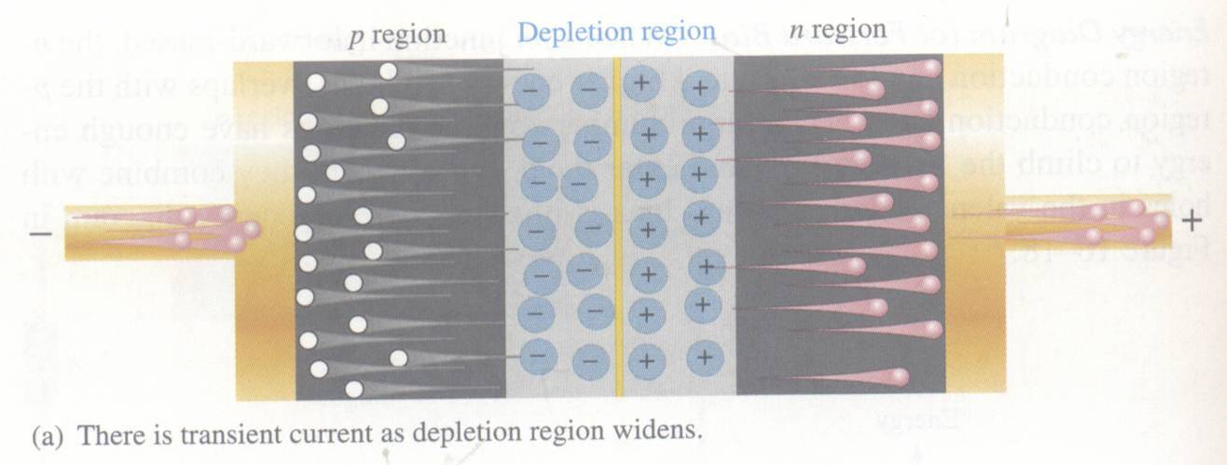
Diodes – Basic Diode Concepts
*Reverse Bias: dc voltage negative terminal connected to the p region and positive to the n region. Depletion region widens until its potential difference equals the bias voltage, majority-carrier current ceases.

Slide 12
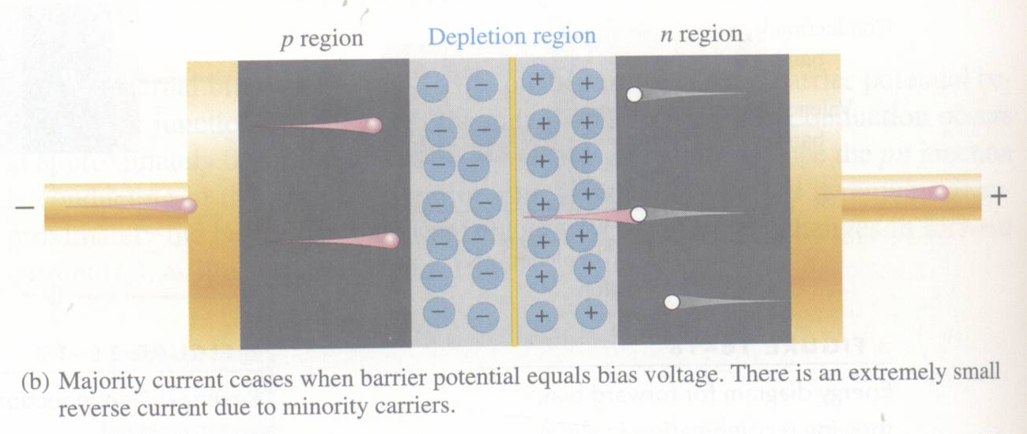
2. Diodes – Basic Diode Concepts
*Reverse Bias:
majority-carrier current ceases.
* However, there is still a very small current produced by minority carriers.

Slide 13
2. Diodes – Basic Diode Concepts
Biasing the PN-Junction
* Reverse Breakdown: As reverse voltage reach certain value, avalanche occurs and generates large current.
Diode Characteristic I-V Curve

Slide 14
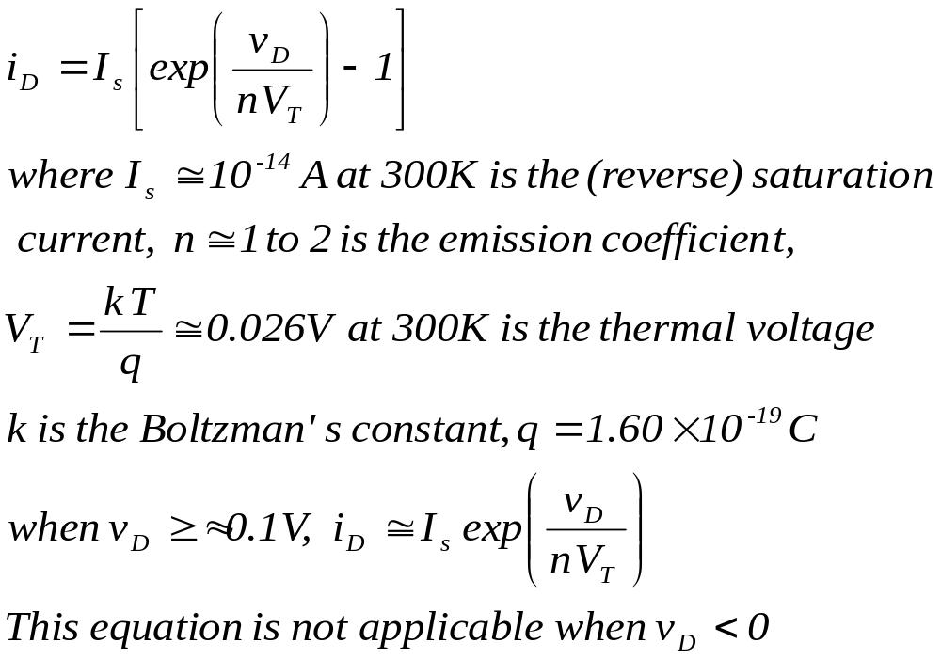
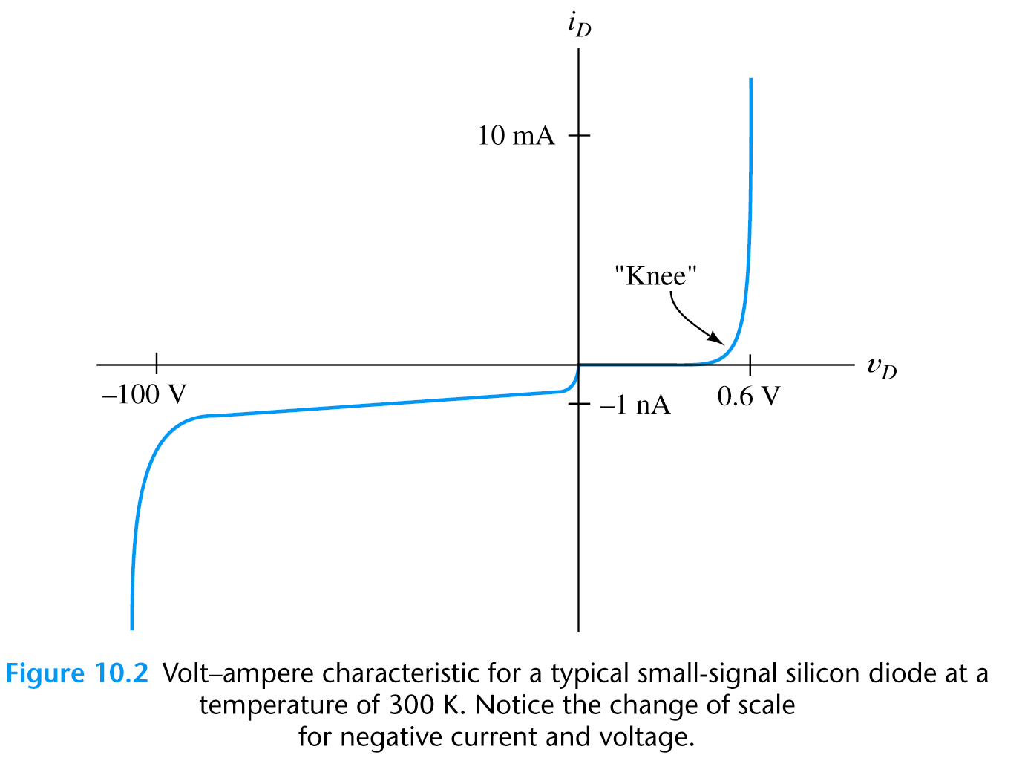
Shockley Equation
* The Shockley equation is a theoretical result under certain simplification:

Slide 15
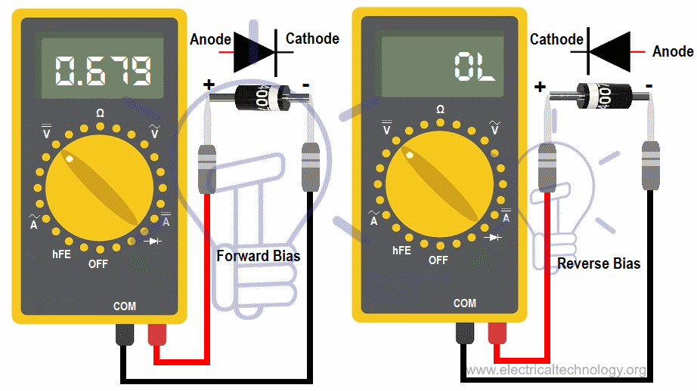
Diode Testing

Slide 16
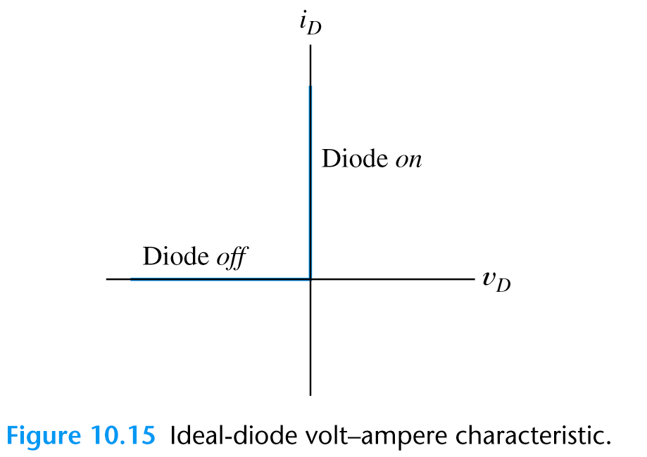
Ideal-Diode Model
* We may apply “Ideal-Diode Model” to simplify the analysis:
(1) in forward direction: short-circuit assumption, zero voltage drop;
(2) in reverse direction: open-circuit assumption.
* The ideal-diode model can be used when the forward voltage drop and reverse currents are negligible.

Slide 17
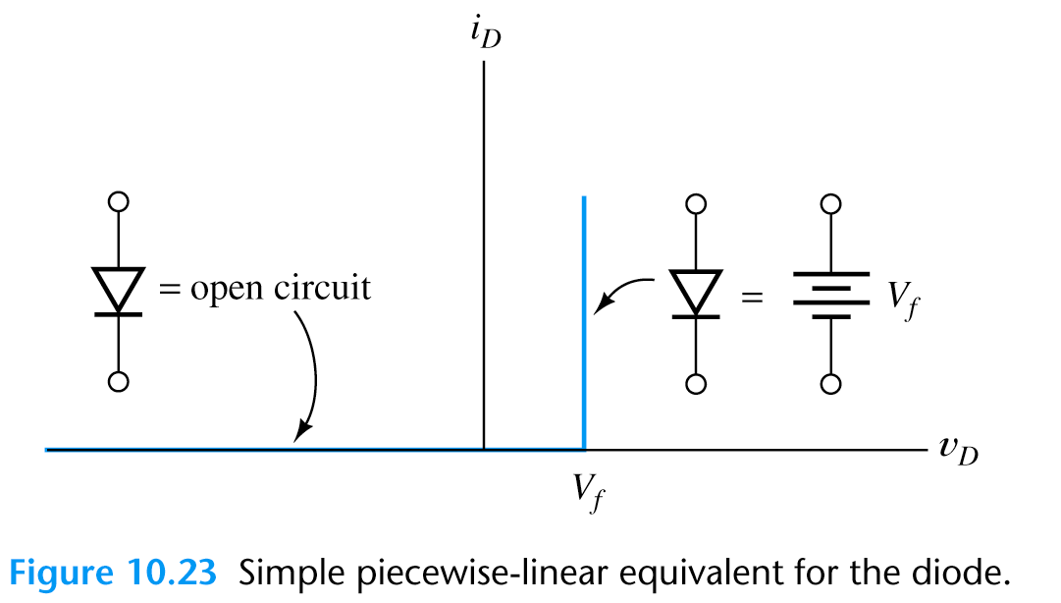
2. Piecewise-Linear Diode Models
Modified Ideal-Diode Model
* This modified ideal-diode model is usually accurate enough in
most of the circuit analysis.

Slide 18
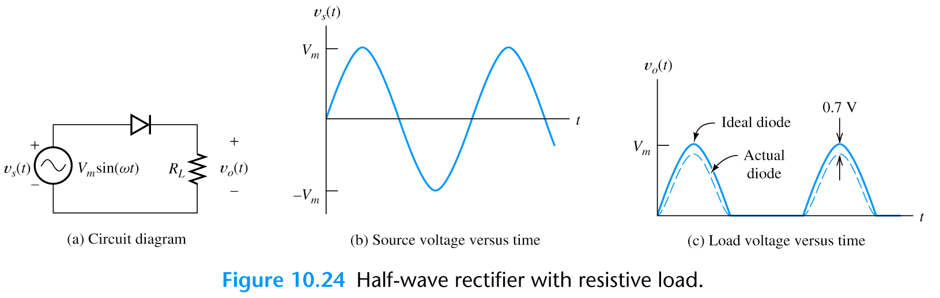
Application
Rectifier Circuits
* Rectifiers convert ac power to dc power.
* Rectifiers form the basis for electronic power suppliers and battery charging circuits.
Half-Wave
Rectifier

Slide 19
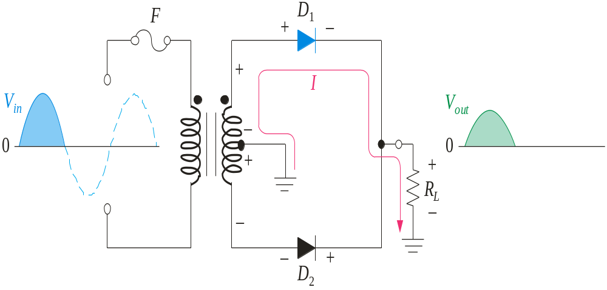
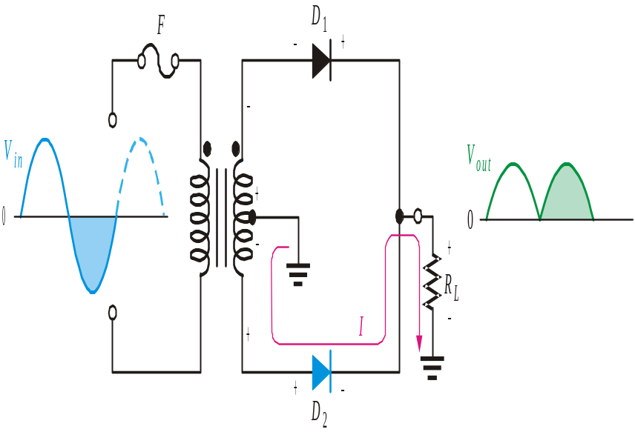
Center-Tapped Full wave rectifiers
A center-tapped transformer is used with two diodes that conduct on alternating half-cycles.
During the negative half-cycle, the lower diode is forward-biased and the upper diode is reverse-biased.
During the positive half-cycle, the upper diode is forward-biased and the lower diode is reverse-biased.
Notes:
Random topics just for revising some concepts.

Slide 20
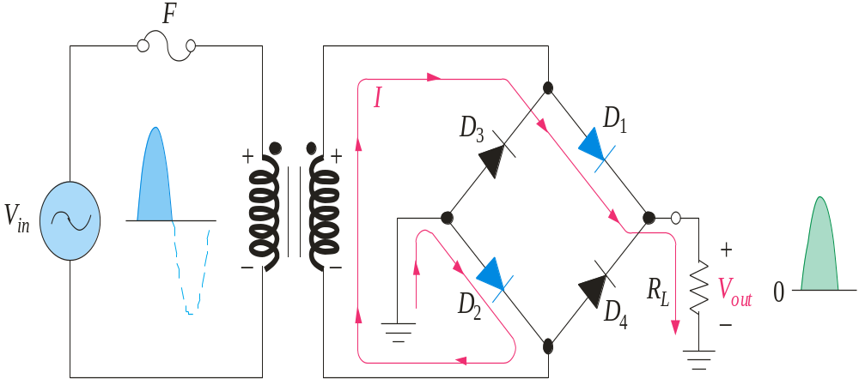
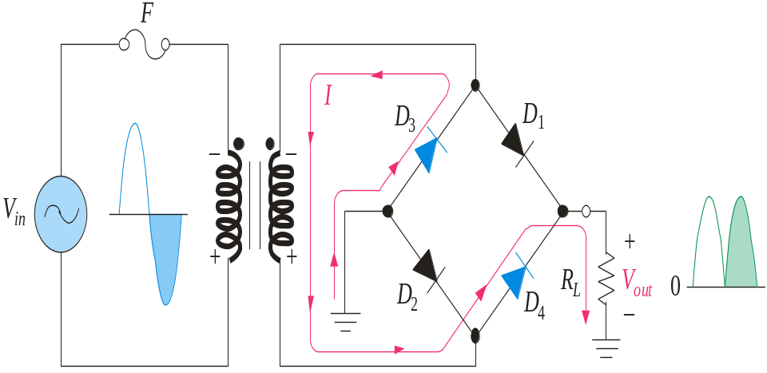
Bridge Full-wave rectifiers
The Bridge Full-Wave rectifier uses four diodes connected across the entire secondary as shown.
Conduction path for the negative half-cycle.
Conduction path for the positive half-cycle.
Notes:
Random topics just for revising some concepts.

Slide 21
MCQ
The forward voltage drop across a silicon diode is about …………………
(a) 0.3 V
(b) 3 V
(C) 7 V
(d) 0.7 V

Slide 22
MCQ
The leakage current in a crystal diode is due to …………….
(a) minority carriers
(b) majority carriers
(C)junction capacitance
(d) none of the above

